Slide 1
Embedded Linux OS
Chapters1-2
2021年12月

Slide 2
Why Linux?
For many well-founded reasons, Linux is being adopted as the operating system in many products beyond its traditional stronghold in server applications.
Because of the numerous economic and technical beneﬁts, we are seeing strong growth in the adoption of Linux for embedded devices

Slide 3
Why Linux?
Some of the reasons for the growth of embedded Linux are as follows:
Linux has emerged as a mature, high-performance, stable alternative to traditional proprietary embedded operating systems.
Linux supports a huge variety of applications and networking protocols.
Linux is scalable, from small consumer-oriented devices to large, heavy-iron, carrier-class switches and routers.

Slide 4
Why Linux?
Linux can be deployed without the royalties required by traditional proprietary embedded operating systems.
Linux has attracted a huge number of active developers, enabling rapid support of new hardware architectures, platforms, and devices.
An increasing number of hardware and software vendors, including virtually all the top-tier manufacturers and ISVs, now support Linux.
For these and other reasons, we are seeing an accelerated adoption rate of Linux in many common household items, ranging from high-definition television sets to cellular handsets.

Slide 5
1.2. Embedded Linux Today
Linux has experienced significant growth in the embedded space
Many companies is building their own embedded Linux distributions
Linux has emerged as the dominant operating system used in thousands of new designs each year.
nearly half of respondents reported using Linux in an embedded design, while the nearest competing operating system was reportedly used by only about one in every eight respondents.
no one can ignore the momentum in the embedded Linux marketplace today.

Slide 6
1.3. Open Source and the GPL
One of the fundamental factors driving the adoption of Linux is the fact that it is open source.
The Linux kernel is licensed under the terms of the GNU GPL (General Public License)
"When we speak of free software, we are referring to freedom, not price.“

Slide 7
The GPL license
Among the most important key characteristics:
  The license is self-perpetuating.
  The license grants the user freedom to run the program.
  The license grants the user the right to study and modify the source code.
  The license grants the user permission to distribute the original code or his modifications.
  The license grants these same rights to anyone to whom you distribute GPL software.

Slide 8
Free Versus Freedom
"free as in freedom" and "free as in beer.“
However, as any professional development manager understands, certain costs are associated with any software to be incorporated into a design.
acquisition, integration, modification,maintenance,and support.
toolchain, libraries, application programs, and specialized cross-development tools

Slide 9
Standards and Relevant Bodies
LBS(Linux Standard Base)
  Probably the single most relevant standard
  establish a set of standards designed to enhance the interoperability of applications among different Linux distributions
  The LSB specifies common attributes of a Linux distribution, including object format, standard library interfaces, minimum set of commands and utilities and their behavior, file system layout, system initialization, and so on.

Slide 10
Standards and Relevant Bodies
Linux Foundation
  the Linux Foundation “is a non-profit consortium dedicated to fostering the growth of Linux.”.
  sponsors the work of Linus Torvalds, the creator of Linux.
  sponsors several working groups to define standards and participate in the development of features targeting many important Linux platform attributes.

Slide 11
Standards and Relevant Bodies
Carrier Grade Linux
  A significant number of the world's largest networking and telecommunications equipment manufacturers are either developing or shipping carrier-class equipment running Linux as the operating system.
  The OSDL Carrier Grade Linux working group has produced a specification defining a set of requirements for carrier-class equipment. The current version of the specification covers seven functional areas:

Slide 12
OSDL: Carrier Grade Linux
seven functional areas:
  Availability Requirements
  Clusters Requirements
  Serviceability Requirements
  Performance Requirements
  Standards Requirements
  Hardware Requirements
  Security Requirements

Slide 13
Standards and Relevant Bodies
Mobile Linux Initiative: Moblin
  The Linux Foundation sponsors a working group called Mobile Linux Initiative.
  To accelerate the adoption of Linux on next-generation mobile handsets and other converged voice/data portable devices.
  The areas of focus for this working group include development tools, I/O and networking, memory management, multimedia, performance, power management, security, and storage.

Slide 14
Standards and Relevant Bodies
Service Availability Forum
  This organization is playing a leading role in defining a common set of interfaces for use in carrier-grade and other commercial equipment for system management.
  The SA Forum website is www.saforum.org.

Slide 15
Summary
Adoption of Linux among developers and manufacturers of embedded products continues to accelerate.
Use of Linux in embedded devices continues to grow at an exciting pace.
In this chapter, we present many of the factors driving the growth of Linux in the embedded market.
Several standards and relevant organizations influencing embedded Linux were presented in this chapter.

Slide 16
Chapter 2. The Big Picture
Many fundamental concepts can present challenges to the newcomer to embedded systems development.
This chapter takes you on a tour of a typical embedded system and the development environment.

Slide 17
Embedded or Not?
Several key attributes are usually associated with embedded systems.
  Contain a processing engine, such as a general-purpose microprocessor
  Typically designed for a specific application or purpose
  Includes a simple (or no) user interface an automotive engine ignition controller, for example
  Often is resource limited for example, has a small memory footprint and no hard drive
  Might have power limitations, such as a requirement to operate from batteries

Slide 18
Embedded or Not?
  Usually is not used as a general-purpose computing platform
  Generally has application software built in, not user selected
  Ships with all intended application hardware and software preintegrated
  Often is intended for applications without human intervention

Slide 19
BIOS Versus Bootloader
Basic Input / Output Software(System)
The BIOS is the first software program of PC. The BIOS first gains control of the processor when power is applied
The BIOS is a complex set of system-configuration software routines that have knowledge of the low level details of the hardware architecture.
The BIOS is a critical piece of the desktop computer. Its primary responsibility is to initialize the hardware, especially the memory subsystem, and load an operating system from the PC's hard drive.

Slide 20
BIOS Versus Bootloader
In an embedded system,the bootloader is the software program that performs these same functions like BOIS.
In your own custom embedded system, part of your development plan must include the development of a bootloader specific to your board.
Chapter 7 discusses bootloaders in detail

Slide 21
BIOS Versus Bootloader
important tasks of bootloader
  Initializes critical hardware components, such as the SDRAM controller, I/O controllers, and graphics controllers
  Initializes system memory in preparation for passing control to the operating system
  Allocates system resources such as memory and interrupt circuits to peripheral controllers, as necessary
  Provides a mechanism for locating and loading your operating system image
  Loads and passes control to the operating system,

Slide 22
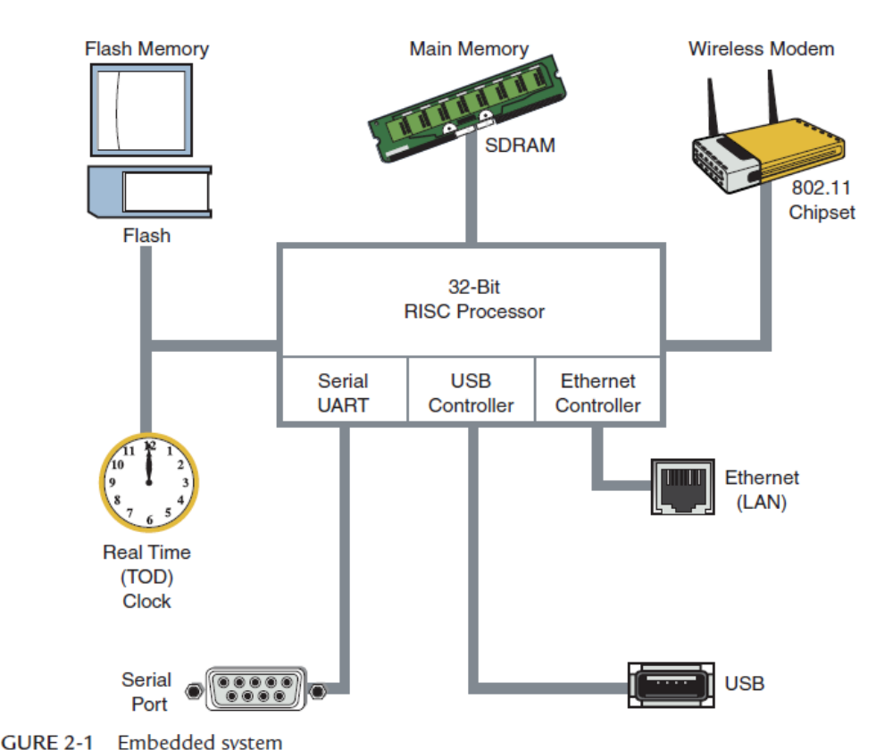
Anatomy of an Embedded System

Slide 23
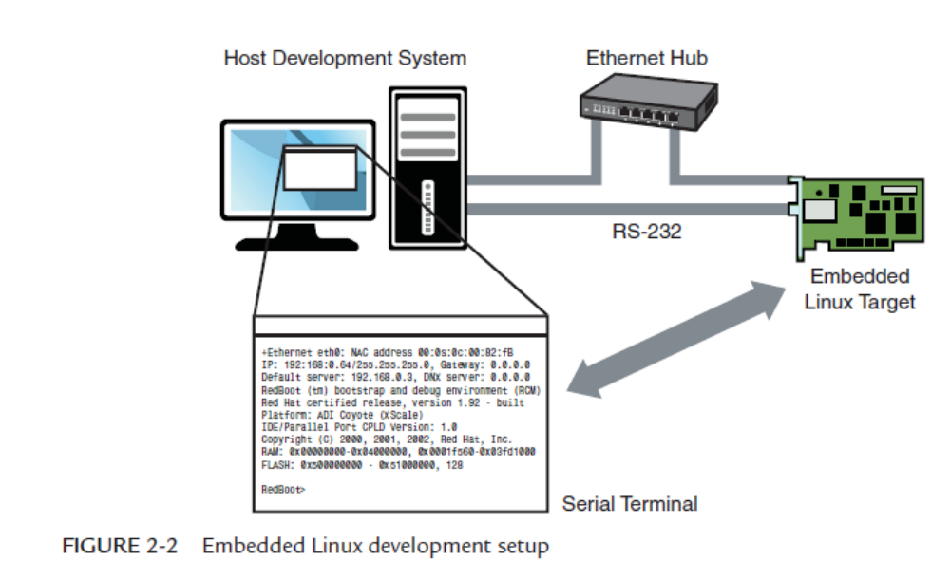
Typical Embedded Linux Setup

Slide 24
Starting the Target Board
When power is first applied, a bootloader supplied with your target board takes immediate control of the processor. It performs some very low-level hardware initialization, including processor and memory setup, initialization of the UART controlling the serial port, and initialization of the Ethernet controller.

Slide 25
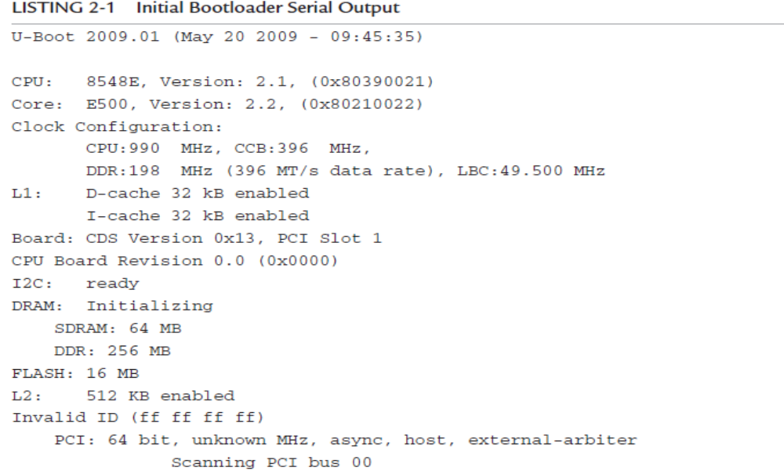
Initial Bootloader Serial Output
U-Boot 1.1.4 (Mar 18 2006 - 20:36:11)
AMCC PowerPC 440EP Rev. B
Board: Yosemite - AMCC PPC440EP Evaluation Board
VCO: 1066 MHz
CPU: 533 MHz
PLB: 133 MHz
OPB: 66 MHz
EPB: 66 MHz
PCI: 66 MHz

Slide 26
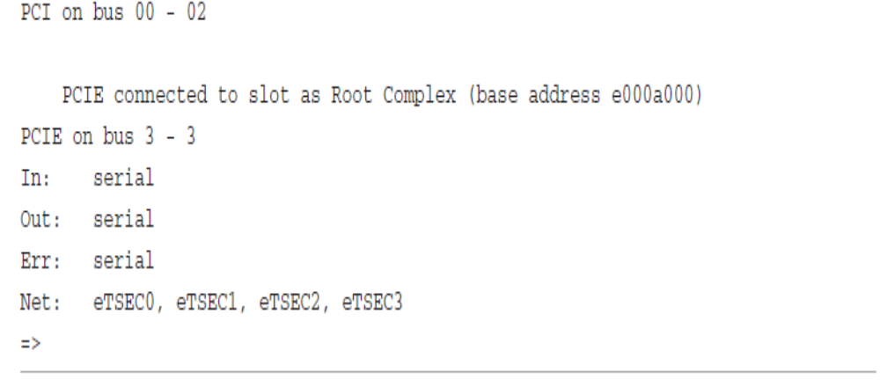
Initial Bootloader Serial Output
I2C: ready
DRAM: 256 MB
FLASH: 64 MB
PCI: Bus Dev VenId DevId Class Int
In: serial
Out: serial
Err: serial
Net: ppc_4xx_eth0, ppc_4xx_eth1
=>

Slide 27
Starting the Target Board
U-Boot configures any hardware subsystems as directed by its static configuration. Here we see I2C, DRAM, FLASH, PCI, and Network subsystems being configured by U-Boot. Finally, U-Boot waits for input from the console over the serial port, as indicated by the => prompt.

Slide 28
Booting the Kernel
To load and boot the Linux kernel. All bootloaders have a command to load and execute an operating system image.

Slide 29
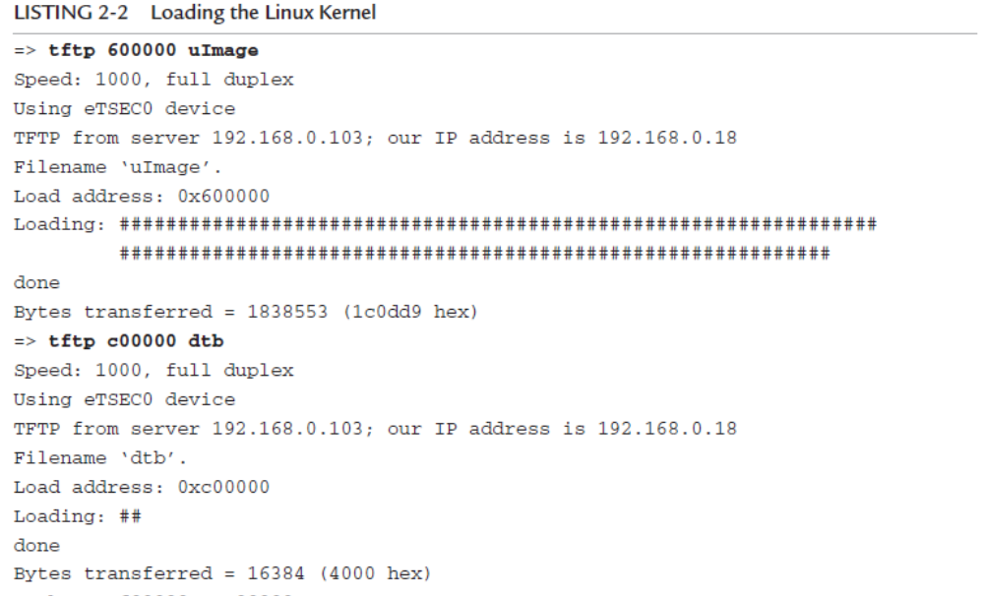
Loading the Linux Kernel
=> tftpboot 200000 uImage-440ep
ENET Speed is 100 Mbps - FULL duplex connection
Using ppc_4xx_eth0 device
TFTP from server 192.168.1.10; our IP address is 192.168.1.139
Filename 'uImage-amcc'.
Load address: 0x200000
Loading: #####################################
##############
done
Bytes transferred = 962773 (eb0d5 hex)

Slide 30
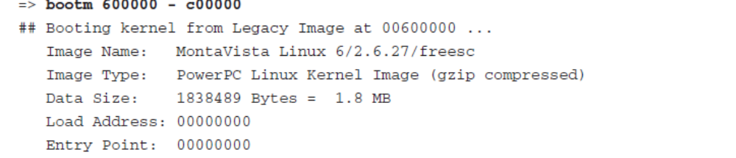
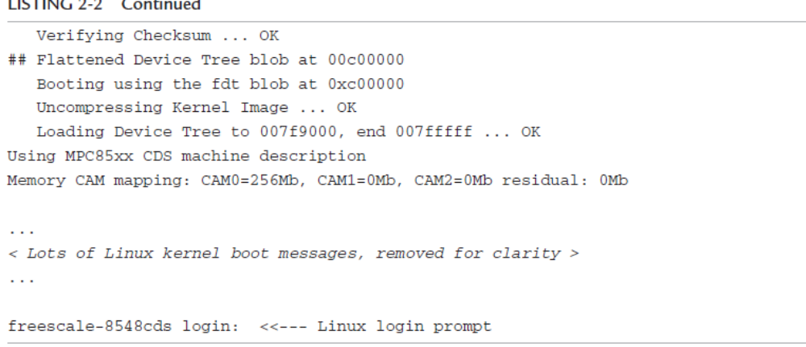
=> bootm 200000
## Booting image at 00200000 ...
Image Name: Linux-2.6.13
Image Type: PowerPC Linux Kernel Image (gzip compressed)
Data Size: 962709 Bytes = 940.1 kB
Load Address: 00000000
Entry Point: 00000000
Verifying Checksum ... OK
Uncompressing Kernel Image ... OK
Linux version 2.6.13 (chris@junior) (gcc version 4.0.0 (DENX ELDK…
#2 Thu Feb 16 19:30:13 EST 2006
AMCC PowerPC 440EP Yosemite Platform
...
< Lots of Linux kernel boot messages, removed for clarity >
...
amcc login: <<< This is a Linux kernel console command prompt

Slide 31
tftpboot command
The tftpboot command instructs U-Boot to load the kernel image uImage into memory over the network using the TFTP protocol.
The tftpboot command is passed an address that is the physical address in the target board's memory where the kernel image will be loaded
=> tftp 600000 uImage
=> tftp c00000 dtb

Slide 32
bootm command
To instruct U-Boot to boot the kernel we just loaded from the address specified by the bootm command.
the bootm command is the death knell for U-Boot. Unlike the PC ,when the Linux kernel takes control, the bootloader ceases to exist.
The only way to pass control back to the bootloader is to reboot the board.
=>bootm 600000 - c00000

Slide 33
Kernel Initialization: Overview
When the Linux kernel begins execution, it spews out numerous status messages during its rather comprehensive boot process.
a high-level understanding of what is happening and what components are required to boot a Linux kernel on an embedded system.

Slide 34
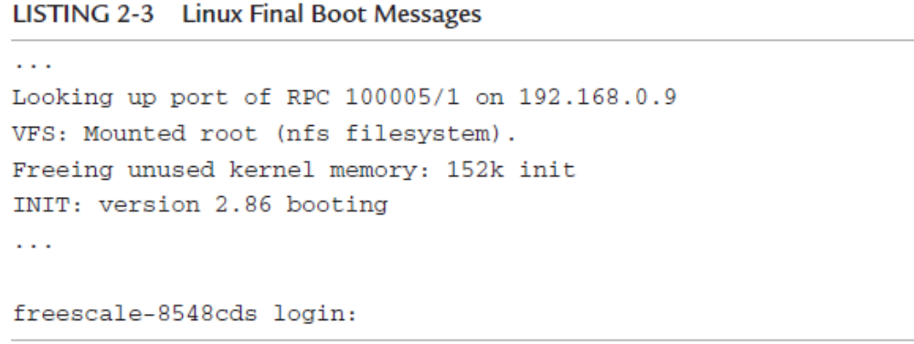
Linux Final Boot Messages
...
Looking up port of RPC 100003/2 on 192.168.0.9
Looking up port of RPC 100005/1 on 192.168.0.9
VFS: Mounted root (nfs filesystem).
Freeing init memory: 232K
INIT: version 2.78 booting
...
coyote login:

Slide 35
mounts a root file system
Shortly before issuing a login prompt on our serial terminal, Linux mounts a root file system.
The root file system contains the application programs, system libraries,and utilities that make up a GNU/Linux system.
The important point in this discussion should not be understated: Linux requires a file system.
NFS (network file systems)

Slide 36
First User Space Process: init
INIT: version 2.86 booting.
When the Linux kernel has completed its internal initialization and mounted its root file system, the default behavior is to spawn an application program called init.
When the kernel starts init, it is said to be running in user space or user space context
These user space processes, or programs, operate in a virtual memory space picked at random and managed by the kernel.
The kernel, in cooperation with specialized memorymanagement hardware in the processor, performs virtual-to-physical address translation for the user space process.

Slide 37
Storage Considerations
Hard drives are bulky, have rotating parts, are sensitive to physical shock, and require multiple power supply voltages, which makes them unsuitable for many embedded systems.
In embedded systems, the hard drive is typically replaced by smaller and less expensive nonvolatile storage devices.

Slide 38
Flash Memory
Nearly everyone is familiar with CompactFlash modules used in a wide variety of consumer devices, such as digital cameras and PDAs
They contain no moving parts, are relatively rugged, and operate on a single common power supply voltage
flash write and erase time is still considerably slower than hard drive.

Slide 39
differences between hard drive and Flash
One of the defining characteristics of Flash memory is the way in which data in Flash is written and erased.
A typical Flash memory device contains many erase blocks.
To modify data stored in a Flash memory array, the block in which the modified data resides must be completely erased.
Another limitation of Flash memory that must be considered is Flash memory cell write lifetime.

Slide 40
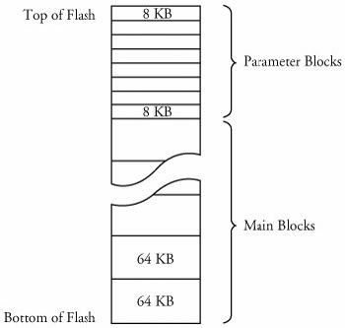

Boot block flash architecture

Slide 41
NAND Flash
NAND Flash is a relatively new Flash technology.
NAND Flash devices improve upon some of the limitations of traditional (NOR) Flash by offering smaller block sizes, resulting in faster and more efficient writes and generally more efficient use of the Flash array.

Slide 42
NAND Flash VS NOR Flash
interface
access
block size.
Write cycle lifetime

Slide 43
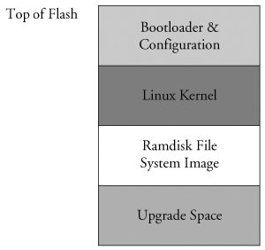
Flash Usage

Slide 44
Flash File Systems
One of the first enhancements to Flash file systems was the incorporation of wear leveling.
Another limitation that arises from the Flash architecture is the risk of data loss during a power failure or premature shutdown.
One of the more popular Flash file systems in use today is JFFS2, or Journaling Flash File System 2.

Slide 45
Memory Space
Virtually all legacy embedded operating systems view and manage system memory as a single large,flat address space.
In traditional embedded systems based on legacy operating systems, the OS and all the tasks had equal access rights to all resources in the system.

Slide 46
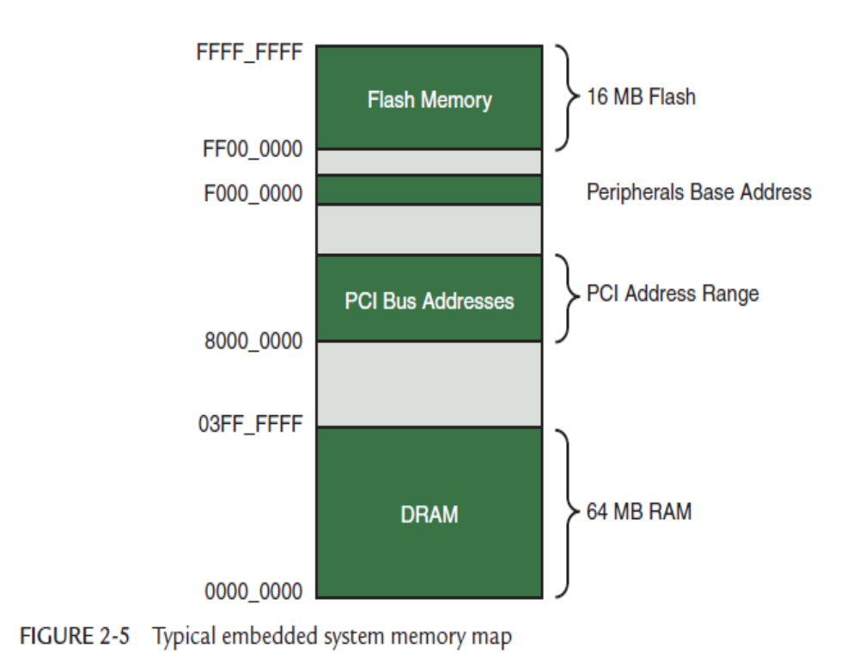
Typical embedded system memory map

Slide 47
Memory Management
Units (MMUs)
High-performance microprocessors contain complex hardware engines called Memory Management Units (MMUs) whose purpose is to enable an operating system to exercise a high degree of management and control over its address space and the address space it allocates to processes.
access rights and memory translation.
The Linux kernel takes advantage of these hardware MMUs to create a virtual memory operating system.

Slide 48
MMU
One of the biggest benefits of virtual memory is that it can make more efficient use of physical memory by presenting the appearance that the system has more memory than is physically present.
The other benefit is that the kernel can enforce access rights to each range of system memory that it allocates to a task or process, to prevent one process from errantly accessing memory or other resources that belong to another process or to the kernel itself.

Slide 49
Execution Contexts
In Linux, we refer to two distinctly separate operational contexts, based on the environment in which a given thread is executing.
kernel context
User space context

Slide 50
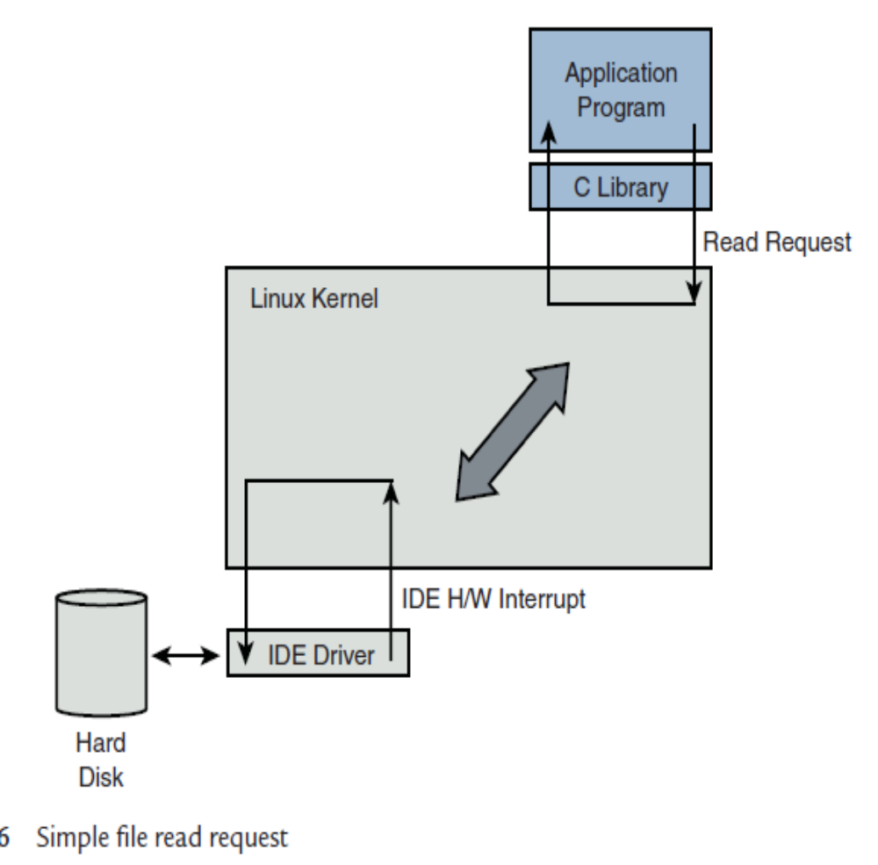
Simple file read request

Slide 51
Process Virtual Memory
When a process is spawned , kernel allocates memory for the process and assigns a range of virtual-memory addresses to the process.
example hello world
Developers of embedded systems often disable swapping on embedded systems because of performance or resource constraints
Without a swap device, you must carefully design your applications to exist within the limitations of your available physical memory

Slide 52
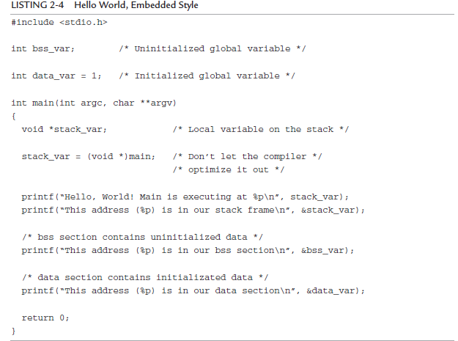

Slide 53
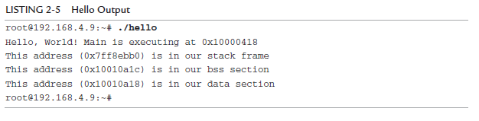

Slide 54
Process Virtual Memory
One of the characteristics of a virtual memory system is that when available physical RAM goes below a designated threshold, the kernel can swap out memory pages to a bulk storage medium, usually a hard disk drive (if available).
Developers of embedded systems often disable swapping on embedded systems because of performance or resource constraints
Without a swap device, you must carefully design your applications to exist within the limitations of your available physical memory

Slide 55
Cross-Development Environment
Developing software in a cross-development environment requires that the compiler running on your development host output a binary executable that is incompatible with the desktop development workstation on which it was compiled.
native compilation
cross-compilation for embedded systems
gcc -Wall -o hello hello.c

Slide 56
Embedded Linux Distributions
After the Linux kernel boots, it expects to find
and mount a root file system. When a suitable root file system has been mounted, startup scripts launch a number of programs and utilities that the system requires. These programs often invoke other programs to do specific tasks, such as spawn a login shell, initialize network interfaces, and launch a user’s applications.

Slide 57
Embedded Linux Distributions
even a small embedded Linux system needs many dozens of files populated in an appropriate directory structure on a root file system
Full-blown desktop systems have many thousands of files on the root file system. These files come from packages that are usually grouped by functionality
rpm is widely used for installing, removing, and updating packages on a Linux system

Slide 58
Embedded Linux Distributions
A complete Linux distribution can contain hundreds or even thousands of packages.
A Linux distribution for embedded targets differs in several significant ways.
  First, the executable target binaries from an embedded distribution will not run on your PC, but are targeted to the architecture and processor of your embedded system
  Another significant difference between desktop and embedded Linux distributions is that an embedded distribution typically contains cross-tools, as opposed to native tools.

Slide 59
Commercial Linux Distributions
There are several vendors of commercial embedded Linux distributions. The leading embedded Linux vendors have been shipping embedded Linux distributions for some years.
Linuxdevices.com

Slide 60
Do-It-Yourself Linux Distributions
You can choose to assemble all the components you need for your embedded project on your own.
you will need a toolchain. Gcc and bin utiles. Both are required to compile the kernel and user-space applications for your project.

Slide 61
Summary
Embedded systems share some common attributes.
The bootloader is a critical component of a typical embedded system.
Several software components are required to boot a custom board, including the bootloader and the kernel and file system image.
Flash memory is widely used as a storage medium in embedded Linux systems.
A properly equipped and configured cross-development environment is crucial to the embedded developer.

